Slide 1
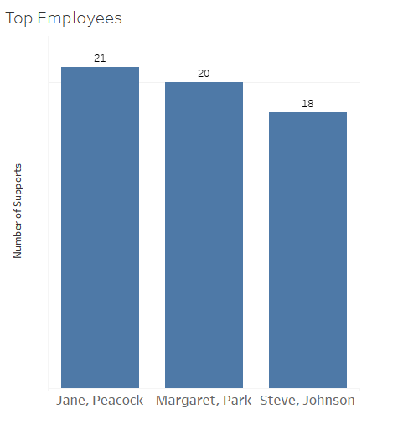
Which employees worked on the most cases?
Jane Peacock is the top employee with 21 cases, Margaret Park is doing fine in the second place with 20 cases, and Steve Johnson can improve his 18 cases
Name

Slide 2
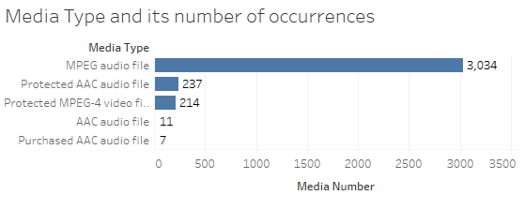
What is the most available media type?
MPEG audio file is the most available media type with 3034 tracks

Slide 3
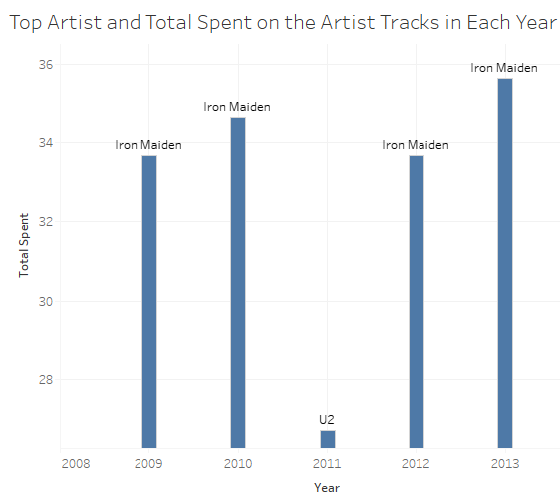
For each year, Which artist has the most sales?
Iron Maiden was the top artist for all years from 2009 to 2013, except in 2011 U2 was the artist with most sales.

Slide 4
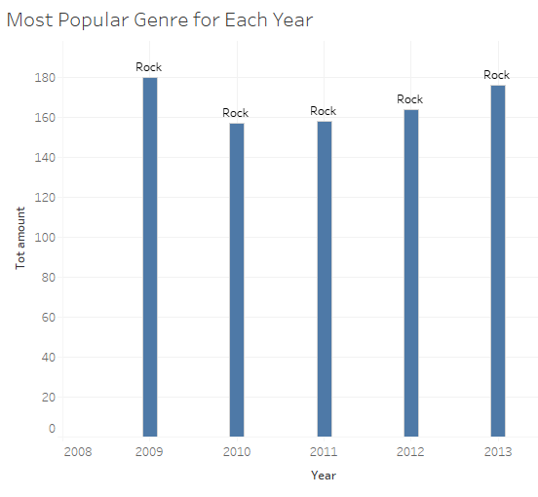
Most popular music genre for each year
Rock is the most popular music genre for all the years from 2009 to 2013.

Slide 5
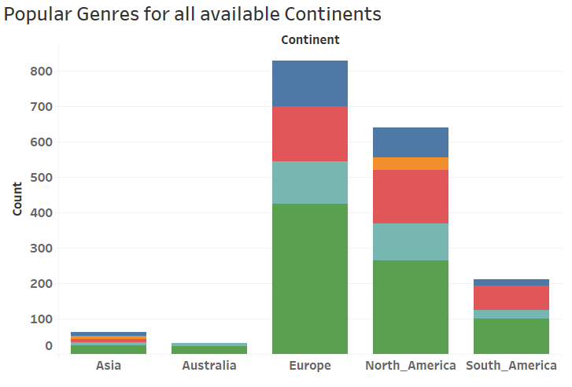
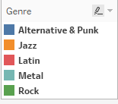
Most popular music genres for each continent
For all continents; Rock is the most popular music genre, Metal is the second and Latin is the third.

